Slide 1



ChinaSys 2024
Soter: Analytical Tensor-Architecture Modeling
and Automatic Tensor Program Tuning
for Spatial Accelerators
Fuyu Wang¹, Minghua Shen¹, Yufei Ding², and Nong Xiao¹
Sun Yat-sen University¹ and University of California, San Diego²
Notes:
大家好我是来自中山大学的王福宇，今天分享是我们发表于ISCA上的工作，面向空间加速器的张量架构解析建模与自动化程序调优

Slide 2




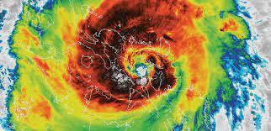

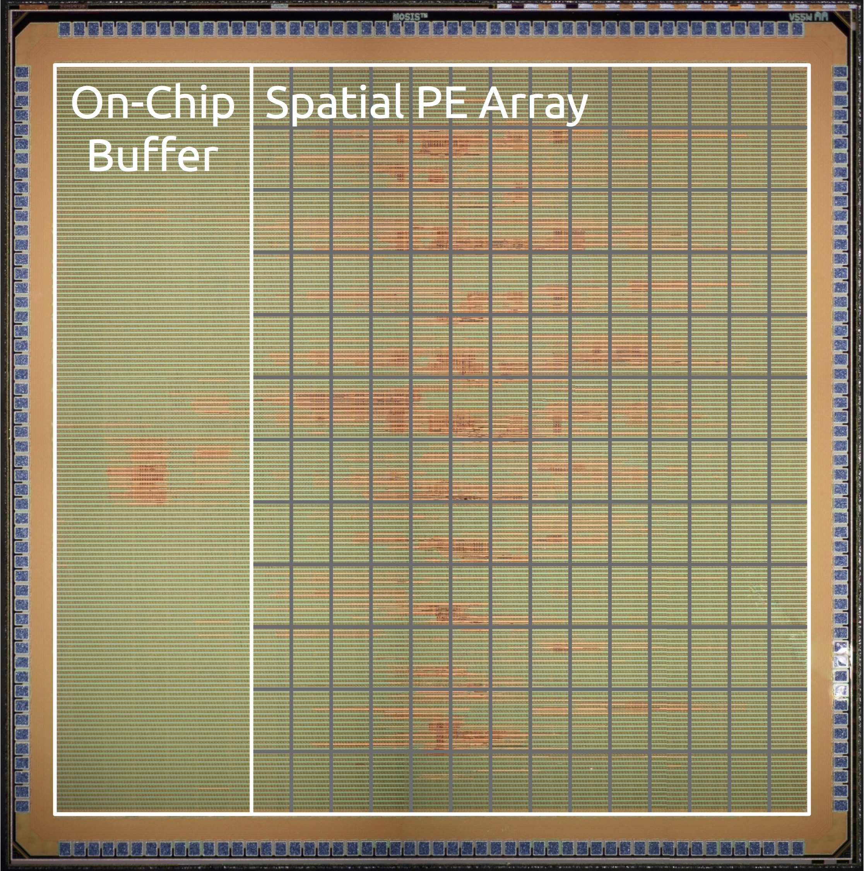
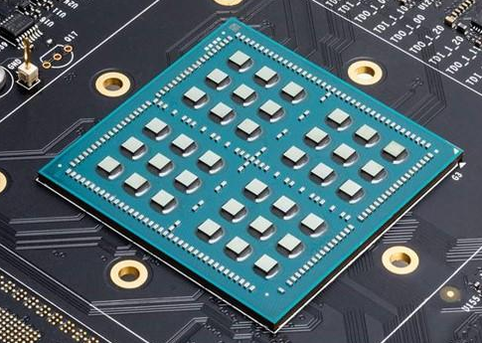
Background
Tensor computations play a crucial role in various applications.
Hardware specialization ushers in a golden age.
CV
NLP
Weather
Forecasting
Healthcare
Eyeriss
Simba
Notes:
现在生活中很多应用，尤其是人工智能，需要张量计算去实现
硬件专业化已经成为加速张量计算的一个潜在方向。

Slide 3
Background: Spatial Architecture
  PE Array: computation parallelism
  Memory Hierarchy: data locality
PE Array
PE
MAC
DRAM
Local Buffer
Global Buffer
…
MAC
Notes:
最近专加速器通常采用空间架构，包含一个大型的处理单元阵列（PE）和多级存储器。
空间加速器面临的主要挑战是张量映射。
它影响了PE阵列的计算并行性和多层存储中的数据局部性。

Slide 4



Background: Tensor Mapping
  Divide tensor computation into sub-tasks and schedule them on PE array
  Loop optimization: tiling, reordering and parallelization
  GEMM(I: [1024, 1024], W: [1024, 1024], O:[1024, 1024])
$I$: 1024x1024 $W$: 1024x1024
1
2
3
4
5
6
7
8
9
10
for n4 = [0 : N4=32) : // DRAM [Step ①]
for k4 = [0 : K4=2) :
…
for c1 = [0 : C1=64) : // PE [Step ③]
for k1 = [0 : K1=8) :
parallel_for c0 = [0 : C0=4) : // MACs [Step ④]
parallel_for n0 = [0 : N0=4) :
n = …, k = …, c = …
O[n,k] += I[n,c] * W[c,k]
… // Write back [Step ⑤]
① Load to DRAM, decompose into 64 smaller GEMMs,
deliver to global buffer
$I_{1}$: 32x1024 $W_{1}$: 1024x512
…
④ Use 64 MAC units for the GEMM,
write the results to accumulation buffer
$O_{2}$: 4x8
⑤ Stores the results from all PEs to global buffer.
(a) Workflow of using the tensor program
(b) Pseudo-code of the tensor program
Notes:
张量映射将张量计算划分为多个子任务，并通过分片等循环优化将这些子任务调度在PE阵列上
(click1) 这张图显示了在Simba加速器上做矩阵乘的一个张量程序， 首先加载输入张量和权重张量，通过分片将计算任务分解成多64个子任务，
利用计算单元计算每个子任务，最后将每个子任务的结果写回。
(click2) 要实现张量程序，需要补全一些可调整的参数，包含分片因子并行因子等，蓝色和红色，
To implement the tensor program in Figure (b), it is required to complement tunable parameters, including tile factors, parallel factors, and loop orders. The blue digits in “for” loops and red digits in “parallel for” loops correspond to temporal factors and parallel factors. The product of them is regarded as a tile factor of each dimension at each level.

Slide 5
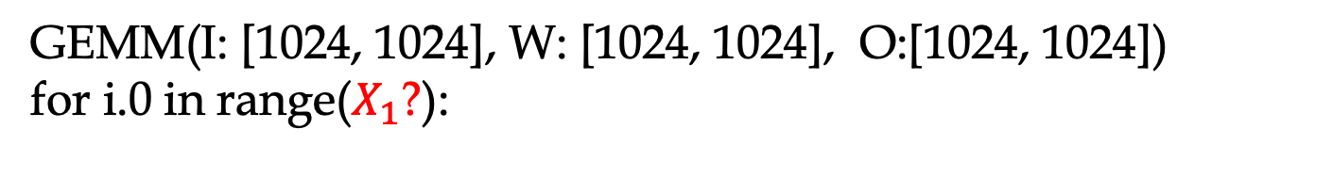

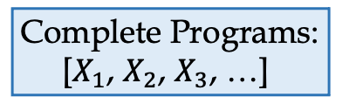
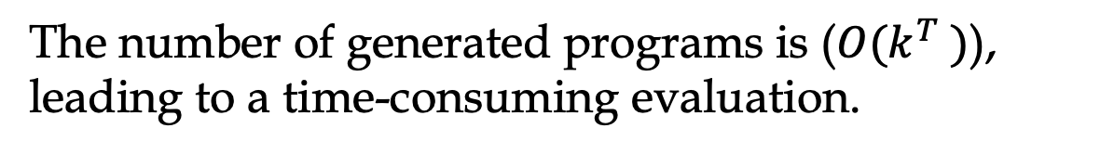
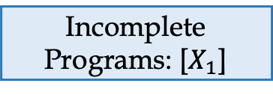


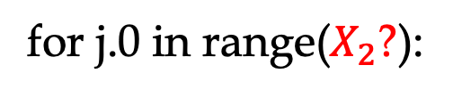

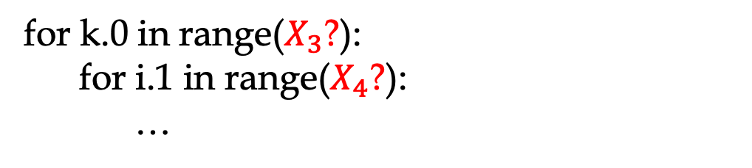
Existing Solutions: Sequence-guided Mapper
  The sequence-guided mappers require to evaluate incomplete programs, which is either inaccurate or time-consuming.
Incomplete
Programs: []
GEMM(I: [1024, 1024], W: [1024, 1024], O:[1024, 1024])
for i.0 in range($X_{1}$?):
① Append $X_{1}$ to []
② Evaluate [$X_{1}$]
③ Determine $X_{1}$
Evaluate all candidates of each tile factor
② Evaluate [$X_{1}$] ?
for j.0 in range($X_{2}$?):
for k.0 in range($X_{3}$?):
for i.1 in range($X_{4}$?):
…
Incomplete
Programs: [$X_{1}$]
① Append $X_{2}$ to [$X_{1}$]
② Evaluate [$X_{1}$,${ X}_{2}$]
③ Determine $X_{2}$
② Evaluate [$X_{1}$,${ X}_{2}$] ?
The challenge stems from the step ②.
Existing cost models are efficient to the complete programs instead of the incomplete ones.
…
The number of generated programs is ($O(k^{T} )$), leading to a time-consuming evaluation.
Complete Programs:
[$X_{1}$, $X_{2}$, $X_{3}$, …]
Notes:
现在有两种自动调优的方法来实现探索这些参数：基于序列的方法和基于模板的方法
(click1) (click2) (click3) 基于序列的映射方法定义了一系列决策，来生成完整的张量程序。这些映射程序需要不断地评估不完整的程序，这种评估要么不准确，要么耗时。
(click4) 这个挑战主要来自于第二步
(click5)他们使用成本模型评估所有不完整的程序，并选择前k个最好，理想情况下，如果成本模型能够准确估计每个不完整程序的性能，则可以做出最佳决策。
但现有的成本模型对完整的程序评估是有效的，而不是针对于不完整的程序。
(click6)增加beam size可以在选择候选者时提供更好的容错性，并增大搜索空间。然而，生成的程序的数量随着序列（T）的长度呈指数级增加。
评估这么多不完整的程序进行也是非常耗时的。
Increasing the beam size (k) can provide better fault tolerance when selecting candidates and expand the search space.
However, the number of generated programs $O(k^{T} )$ increases exponentially with the length of sequence (T).
Featurizing so numerous incomplete programs for evaluation is time-consuming.
They evaluate all of the incomplete programs using a cost model and select top-k candidates
Ideally, the mappers can make the best decision if the cost models can accurately estimate the performance of each incomplete program.
Unfortunately, existing cost models are efficient to the complete programs instead of the incomplete ones.
The inaccurate estimation also misleads the subsequent decisions and results in cumulative errors.
(click6) Increasing the beam size (k) can provide better fault tolerance when selecting candidates and expand the search space.
However, the number of generated programs $O(k^{T} )$ increases exponentially with the length of sequence (T).
Featurizing so numerous incomplete programs for evaluation is time-consuming.
In general, the sequence-guided mappers cannot provide comparable performance to the template-guided ones.

Slide 6

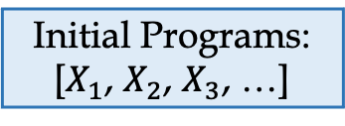


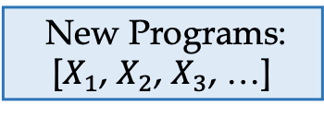
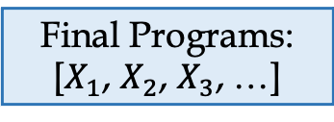

Existing Solutions: Template-guided Mapper
  The template-guided mappers require to determine all of the tunable parameters simultaneously, which leads to a large number of invalid programs.
1
2
3
4
5
6
7
8
for c4 = [0 : C4=1) : // DRAM
for n4 = [0 : N4=32) :
for k4 = [0 : K4=2) :
…
for c1 = [0 : C1=64) :
for k1 = [0 : K1=8) :
n = …, k = …, c = …
O[n,k] += I[n,c] * W[c,k]
Initial Programs: [$X_{1}$, $X_{2}$, $X_{3}$, …]
Simba | Buffer Capacity | Global buffer≤64KB
 |  | Input buffer≤8KB
 |  | Weight buffer≤32KB
 |  | Accumulation buffer≤3KB
 | Spatial Capacity | PEs≤16
 |  | MACs≤64
NVDLA | … | …
① Determine [$X_{1}$, $X_{2}$, …]
② Evaluate [$X_{1}$, $X_{2}\text{, …}$]
① Determine [$X_{1}$, $X_{2}$, …] ?
New Programs:
[$X_{1}$, $X_{2}$, $X_{3}$, …]
① Determine [$X_{1}$, $X_{2}$, …]
② Evaluate [$X_{1}$, $X_{2}\text{, …}$]
① Determine [$X_{1}$, $X_{2}$, …] ?
…
The challenge stems from the step ①.
The template-guided mappers cannot accurately constrain the sub-space of each parameter in step ①.
More than 50% of programs tuned by them are invalid.
Final Programs:
[$X_{1}$, $X_{2}$, $X_{3}$, …]
③ Optimize
Notes:
基于模板的映射方法在完整的程序上进行自动调优
(click1)这些方法需要同时确定所有可调参数，这会导致大量无效程序。
(click2) 这个挑战主要来自于第一步
(click3)每个可调参数的子空间是相互影响。它们受到加速器中存储能力和空间能力的约束。
例如，在确定C4＝1之后，N4和K4的子空间需要动态更新以满足存储能力的约束。
选择子空间以外的值会导致程序无效。
(click4)在步骤①中，基于模板的映射方法不能准确地约束每个参数的子空间。生成大量无效的解方案。
The template-guided mappers perform auto-tuning throughout the complete programs.
(click1) These mappers require to determine all of the tunable parameters simultaneously, which leads to a large number of invalid programs.
(click2) The challenge stems from the step ①.
(click3) The sub-spaces of tunable parameters (e.g., tile factor and parallel factor) influence each other. They are constrained by buffer capacity and spatial capacity of the spatial accelerator.
For example, after determining C4=1, the sub-spaces of N4 and K4 requires to be dynamically updated to satisfy the global buffer capacity.
Choosing values beyond sub-spaces leads to invalid programs.
(click4) The template-guided mappers cannot accurately constrain the sub-space of each parameter in step ①.
More than 50% of programs tuned by them are invalid

Slide 7
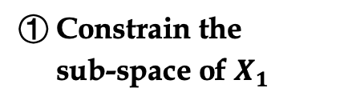
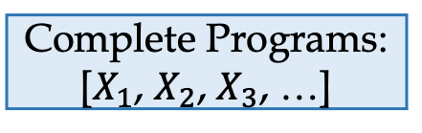

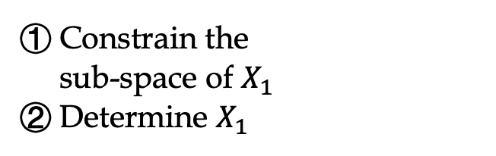
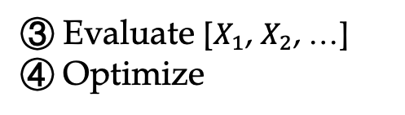
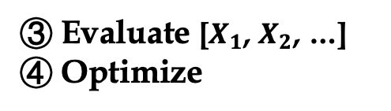
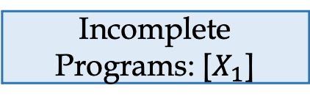
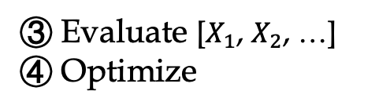



Our Solution: Soter
Step ①: Constrain each tunable parameter's sub-space.
    An analytical tensor-architecture model, to exclude invalid candidates in the program design space.
Incomplete Programs: []
① Constrain the
sub-space of $X_{1}$
② Determine $X_{1}$
① Constrain the
sub-space of $X_{1}$
② Determine $X_{1}$
① Constrain the
sub-space of $X_{1}$
Step ②③④: Sequentially decide on tunable parameters,
Evaluate the complete programs,
Perform optimization.
    An automatic program tuner, to avoid evaluating incomplete programs and to converge to high-performance solutions
② Determine $X_{1}$
Incomplete
Programs: [$X_{1}$]
① Constrain the
sub-space of $X_{2}$
② Determine $X_{2}$
① Constrain the
sub-space of $X_{2}$
② Determine $X_{2}$
…
Complete Programs:
[$X_{1}$, $X_{2}$, $X_{3}$, …]
Step ①②:
    A coordination between analytical modeling and automatic tuning, to optimize both tensor programs and program design space.
③ Evaluate [$X_{1}$, $X_{2}\text{, …}$]
④ Optimize
③ Evaluate [$X_{1}$, $X_{2}\text{, …}$]
④ Optimize
③ Evaluate [$X_{1}$, $X_{2}\text{, …}$]
④ Optimize
Notes:
我们提出了Soter，一种用于空间加速器的自动调谐张量映射框架。
（点击）步骤①：Soter首先约束每个可调参数的子空间。
我们提出了一个分析张量体系结构模型，在该模型中，我们在可调参数和体系结构约束之间建立了一组不等式。
通过求解不等式，Soter排除了程序设计空间中的无效候选者。
（点击）步骤②③④：Soter做出一系列决定来确定可调参数，评估完整的程序并进行优化。
我们提出了一种自动程序调谐器，利用Transformer结构，因为它在序列建模中具有强大的能力。每个张量程序都被视为一个语言序列，而可调参数则被视为语言标记。
将Transformer与策略梯度算法相结合，调谐器可以选择最佳的探索方向，而不是前k个候选者。
Transformer在以稀疏奖励为特征的场景中是有利的。这样，我们只需要评估完整的程序。
（点击）步骤①②：Soter在分析建模和自动调优之间建立协调，优化张量程序和程序设计空间。
分析模型为调谐器生成程序设计空间。
调谐器通过顺序决策使模型更新子空间。
与模板引导的映射器相比，Soter旨在排除搜索空间中的无效程序候选者。
与序列引导映射器相比，Soter的目标是选择最佳勘探方向，而不是前k个候选者，并依赖于对完整程序的准确估计。

Slide 8
Soter: Overview
GEMM
for N [0 : 1024)
for K [0 : 1024)
for C = [0 : 1024)
Output[...] += Input[…] * Weight[…]
Coordination ① ②
①
Tensor
Computations
Tensor Program
Design Space
Sub-spaces of tunable params.
Automatic Tuner
Analytical Model
GEMM
C2D
Satisfy
Buffer Capacity
Transformer-based
Exploration
High-performance
Tensor Program
…
Spatial
Architectures
Tunable Params.
Tile factor
Parallel factor
Loop order
Satisfy
Spatial Capacity
Policy Gradient-based
Optimization
Simba
NVDLA
②
…
DRAM
Input Buffer
Weight Buffer
Simba
Global Buffer
Acc. Buffer
PE
…
PE
MAC
…
MAC

Slide 9






Soter: Overview
Acc. buffer
…
Buf.
Global buffer
Dim.
$$N_{5}$$ | $$K_{5}$$ | $$C_{5}$$
$$N_{2}$$ | $$K_{2}$$ | $$C_{2}$$
$X_{t}$(max)
1024
1024
1024
256
256
256
Tensor Program
Design Space
$X_{t}$(min)
4 | 4 | 4
4 | 4 | 1
$X_{p}$(max)
 |  | 4
16 | 4 | 1
64
16
$X_{p}$(min)
1 | 1 | 4
1 | 1 | 1
Coordination ① ②
①
Tensor
Computations
Tensor Program
Design Space
Sub-spaces of tunable params.
Automatic Tuner
Analytical Model
GEMM
C2D
Satisfy
Buffer Capacity
Transformer-based
Exploration
High-performance
Tensor Program
…
Spatial
Architectures
Tunable Params.
Tile factor
Parallel factor
Loop order
Satisfy
Spatial Capacity
Policy Gradient-based
Optimization
Simba
NVDLA
②
…

Slide 10





Soter: Overview
Coordination ① ②
①
Tensor
Computations
Tensor Program
Design Space
Sub-spaces of tunable params.
Automatic Tuner
Analytical Model
GEMM
C2D
Satisfy
Buffer Capacity
Transformer-based
Exploration
High-performance
Tensor Program
…
Spatial
Architectures
Tunable Params.
Tile factor
Parallel factor
Loop order
Satisfy
Spatial Capacity
Policy Gradient-based
Optimization
Simba
NVDLA
②
…
…
Buf.
Acc. buffer
Global buffer
Dim.
$$N_{5}$$ | $$K_{5}$$ | $$C_{5}$$
$$N_{2}$$ | $$K_{2}$$ | $$C_{2}$$
$$X_{t}$$
4 | 4 | 4
8 | 64 | 4
Sequence of the
tensor program
$$X_{p}$$
4 | 4 | 4
4 | 4 | 1
$$X_{d}$$
2 | 3 | 1
2 | 3 | 1
Pos.
1 | 2 | 3
4
5
6
…

Slide 11
Soter: Overview
Coordination ① ②
①
Tensor
Computations
Tensor Program
Design Space
Sub-spaces of tunable params.
Automatic Tuner
Analytical Model
GEMM
C2D
Satisfy
Buffer Capacity
Transformer-based
Exploration
High-performance
Tensor Program
…
Spatial
Architectures
Tunable Params.
Tile factor
Parallel factor
Loop order
Satisfy
Spatial Capacity
Policy Gradient-based
Optimization
Simba
NVDLA
②
…

Slide 12
Soter: Analytical tensor-architecture model
  Satisfy Buffer Capacity:
  ① Tensors are stored in the multi-level memory hierarchy;
Simba …
①
Input
Tensor
Accumulation Buffer
Weight Buffer
Input Buffer
Global Buffer
Weight
Tensor
Output
Tensor

Slide 13

Soter: Analytical tensor-architecture model
  Satisfy Buffer Capacity:
  ① Tensors are stored in the multi-level memory hierarchy;
  ② The tensor size cannot exceed the buffer capacity;
Simba …
①
Input
Tensor
Accumulation Buffer
Weight Buffer
Input Buffer
Global Buffer
Weight
Tensor
Output
Tensor
②
Input size + Output size $≤$ Global buffer size

Slide 14

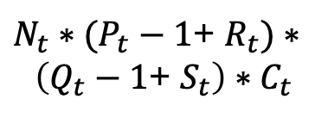
Soter: Analytical tensor-architecture model
  Satisfy Buffer Capacity:
  ① Tensors are stored in the multi-level memory hierarchy;
  ② The tensor size cannot exceed the buffer capacity;
  ③ The tensor size is related to the tiling of each dimension;
C2D …
Simba …
③
①
N
K
C
P
Q
R
S
Input
Tensor
Accumulation Buffer
Weight Buffer
Input Buffer
Global Buffer
$N_{t}∗(P_{t}−1$+ $R_{t})∗$
$$\left(Q_{t}−1\text{+ }S_{t}\right)∗C_{t}$$
Weight
Tensor
$$N_{t}∗P_{t}∗Q_{t}∗K_{t}$$
②
③
③
Output
Tensor
Input size + Output size $≤$ Global buffer size

Slide 15
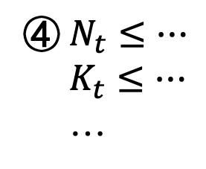
Soter: Analytical tensor-architecture model
  Satisfy Buffer Capacity:
  ① Tensors are stored in the multi-level memory hierarchy;
  ② The tensor size cannot exceed the buffer capacity size;
  ③ The tensor size is related to the tiling of each dimension;
  ④ We can build a set of inequalities: the tile factor of each dimension
  is constrained by the buffer capacity.
④ $N_{t}≤…$
$K_{t}≤…$
…
C2D …
Simba …
③
①
N
K
C
P
Q
R
S
Input
Tensor
Accumulation Buffer
Weight Buffer
Input Buffer
Global Buffer
$N_{t}∗(P_{t}−1$+ $R_{t})∗$
$$\left(Q_{t}−1\text{+ }S_{t}\right)∗C_{t}$$
Weight
Tensor
$$N_{t}∗P_{t}∗Q_{t}∗K_{t}$$
②
③
③
Output
Tensor
Input size + Output size $≤$ Global buffer size
Notes:
计算过程再详细一点x

Slide 16


Soter: Analytical tensor-architecture model
  Satisfy Buffer Capacity:
  ① Tensors are stored in the multi-level memory hierarchy;
  ② The tensor size cannot exceed the buffer capacity size;
  ③ The tensor size is related to the tiling of each dimension;
  ④ We can build a set of inequalities: the tile factor of each dimension
  is constrained by the buffer capacity.
④ $N_{t}≤…$
$K_{t}≤…$
…
GEMM …
Simba …
③
①
N
K
C
Input
Tensor
Accumulation Buffer
Weight Buffer
Input Buffer
Global Buffer
Weight
Tensor
$$N_{t}∗C_{t}$$
$$N_{t}∗K_{t}$$
②
③
③
Output
Tensor
Input size + Output size $≤$ Global buffer size
Notes:
计算过程再详细一点x

Slide 17
Soter: Analytical tensor-architecture model
  Satisfy Spatial Capacity:
  ① The number of tiles is enough to satisfy buffer capacity;
Notes:
计算过程再详细一点x

Slide 18
Soter: Analytical tensor-architecture model
  Satisfy Spatial Capacity:
  ① The number of tiles is enough to satisfy buffer capacity;
  ② The number of tiles is enough to satisfy spatial capacity;
Notes:
计算过程再详细一点x

Slide 19



Soter: Analytical tensor-architecture model
  Satisfy Spatial Capacity:
  ① The number of tiles is enough to satisfy buffer capacity;
  ② The number of tiles is enough to satisfy spatial capacity;
  Tile
GEMM:
$T(N_{t})∗{T(C}_{t})∗$ $T\left(K_{t}\right)≈$ ${Cap}_{S}$
  Tiles
$P(N_{t})∗{T(C}_{t})∗$ $T\left(K_{t}\right)≈{Cap}_{S}$
…
$P(N_{t})∗{P(C}_{t})∗$ $P\left(K_{t}\right)≈{Cap}_{S}$
  PE Array

Slide 20











Soter: Automatic program tuner
  Transformer-based Exploration: each tensor program is regarded as a language sequence while the tunable parameters are regarded as tokens.
Acc.
buffer
Global
buffer
Weight
buffer
Input
buffer
Buf.
DRAM
Sequence 𝑋 of Tensor Program
Dim.
$$N_{5}$$ | $$K_{5}$$ | $$C_{5}$$
$$N_{2}$$ | $$K_{2}$$ | $$C_{2}$$
$$N_{4}$$ | $$K_{4}$$ | $$C_{4}$$
$$N_{3}$$ | $$K_{3}$$ | $$C_{3}$$
$$N_{1}$$ | $$K_{1}$$ | $$C_{1}$$
Token embedding
$$X_{t}$$
4 | 4 | 4
8 | 64 | 4
1 | 2 | 64
1 | 1 | 1
32 | 2 | 1
$$X_{p}$$
4 | 4 | 4
4 | 4 | 1
1 | 1 | 1
1 | 1 | 1
1 | 1 | 1
Multi-head
attention
Feed
forward
$$X_{d}$$
2 | 3 | 1
2 | 3 | 1
2 | 3 | 1
2 | 3 | 1
2 | 3 | 1
Pos.
1 | 2 | 3
4 | 5 | 6
7 | 8 | 9
10
11
12
13
14
15
Linear
softmax
Linear
softmax
Linear
softmax
Tile factor $X_{t}$
Parallel factor $X_{p}$
Loop order $X_{d}$

Slide 21
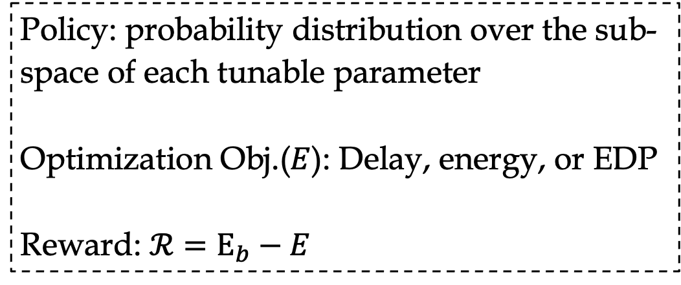
Soter: Automatic program tuner
  Policy Gradient-based Optimization: estimate the optimization objective of complete mapping candidates and design reward
Sequence 𝑋 of Tensor Program
  Policy: probability distribution over the sub-space of each tunable parameter
  Optimization Obj.($E$): Delay, energy, or EDP
  Reward: $ℛ=E_{b}−E$
Token embedding
Multi-head
attention
Feed
forward
Linear
softmax
Linear
softmax
Linear
softmax
Tile factor $X_{t}$
Parallel factor $X_{p}$
Loop order $X_{d}$

Slide 22
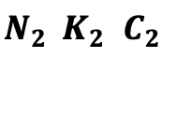










Soter: Coordination
  The analytical model defines the sub-space of a certain tuner parameter with maximum and minimum values for the program tuner.
Acc.
buffer
Global
buffer
Weight
buffer
Input
buffer
Buf.
DRAM
Dim.
$$N_{5}$$ | $$K_{5}$$ | $$C_{5}$$
$$N_{2}$$ | $$K_{2}$$ | $$C_{2}$$
$$N_{4}$$ | $$K_{4}$$ | $$C_{4}$$
$$N_{3}$$ | $$K_{3}$$ | $$C_{3}$$
$$N_{1}$$ | $$K_{1}$$ | $$C_{1}$$
$X_{t}$(max)
1024
512
1024
256
256
256
4
4
64
1
2
1
-
-
-
The maximum and minimum values of tile factors
$X_{t}$(min)
4 | 4 | 4
4 | 4 | 1
1 | 1 | 1
1 | 1 | 1
- | - | -
$$X_{t}$$
4 | 4 | 4
8 | 64 | 4
1 | 2 | 64
1 | 1 | 1
32 | 2 | 1
$X_{p}$(max)
64 | 16 | 4
16 | 4 | 1
1 | 1 | 1
1 | 1 | 1
- | - | -
The maximum and minimum values of parallel factors
$X_{p}$(min)
1 | 1 | 4
1 | 1 | 1
1 | 1 | 1
1 | 1 | 1
- | - | -
$$X_{p}$$
4 | 4 | 4
4 | 4 | 1
1 | 1 | 1
1 | 1 | 1
1 | 1 | 1
$$X_{d}$$
2 | 3 | 1
2 | 3 | 1
2 | 3 | 1
2 | 3 | 1
2 | 3 | 1
Pos.
1 | 2 | 3
4 | 5 | 6
7 | 8 | 9
10
11
12
13
14
15
Notes:
修改数据

Slide 23
Soter: Coordination
  The analytical model defines the sub-space of a certain tuner parameter with maximum and minimum values for the program tuner.
  The program tuner makes the analytical model update the sub-spaces of subsequent parameters through sequential decisions.
Acc.
buffer
Global
buffer
Weight
buffer
Input
buffer
Buf.
DRAM
Dim.
$$N_{5}$$ | $$K_{5}$$ | $$C_{5}$$
$$N_{2}$$ | $$K_{2}$$ | $$C_{2}$$
$$N_{4}$$ | $$K_{4}$$ | $$C_{4}$$
$$N_{3}$$ | $$K_{3}$$ | $$C_{3}$$
$$N_{1}$$ | $$K_{1}$$ | $$C_{1}$$
$X_{t}$(max)
1024
512
1024
256
256
256
4
4
64
1
2
1
-
-
-
The maximum and minimum values of tile factors
$X_{t}$(min)
4 | 4 | 4
4 | 4 | 1
1 | 1 | 1
1 | 1 | 1
- | - | -
$$X_{t}$$
4 | 4 | 4
8 | 64 | 4
1 | 2 | 64
1 | 1 | 1
32 | 2 | 1
$X_{p}$(max)
64 | 16 | 4
16 | 4 | 1
1 | 1 | 1
1 | 1 | 1
- | - | -
The maximum and minimum values of parallel factors
$X_{p}$(min)
1 | 1 | 4
1 | 1 | 1
1 | 1 | 1
1 | 1 | 1
- | - | -
$$X_{p}$$
4 | 4 | 4
4 | 4 | 1
1 | 1 | 1
1 | 1 | 1
1 | 1 | 1
$$X_{d}$$
2 | 3 | 1
2 | 3 | 1
2 | 3 | 1
2 | 3 | 1
2 | 3 | 1
Pos.
1 | 2 | 3
4 | 5 | 6
7 | 8 | 9
10
11
12
13
14
15
Notes:
修改数据

Slide 24
Evaluation
  Spatial Accelerators: Eyeriss, Simba, and NVDLA
  Baselines: AutoTVM, FlexTensor, Mind Mappings, and CoSA
  Platform: Timeloop

Slide 25
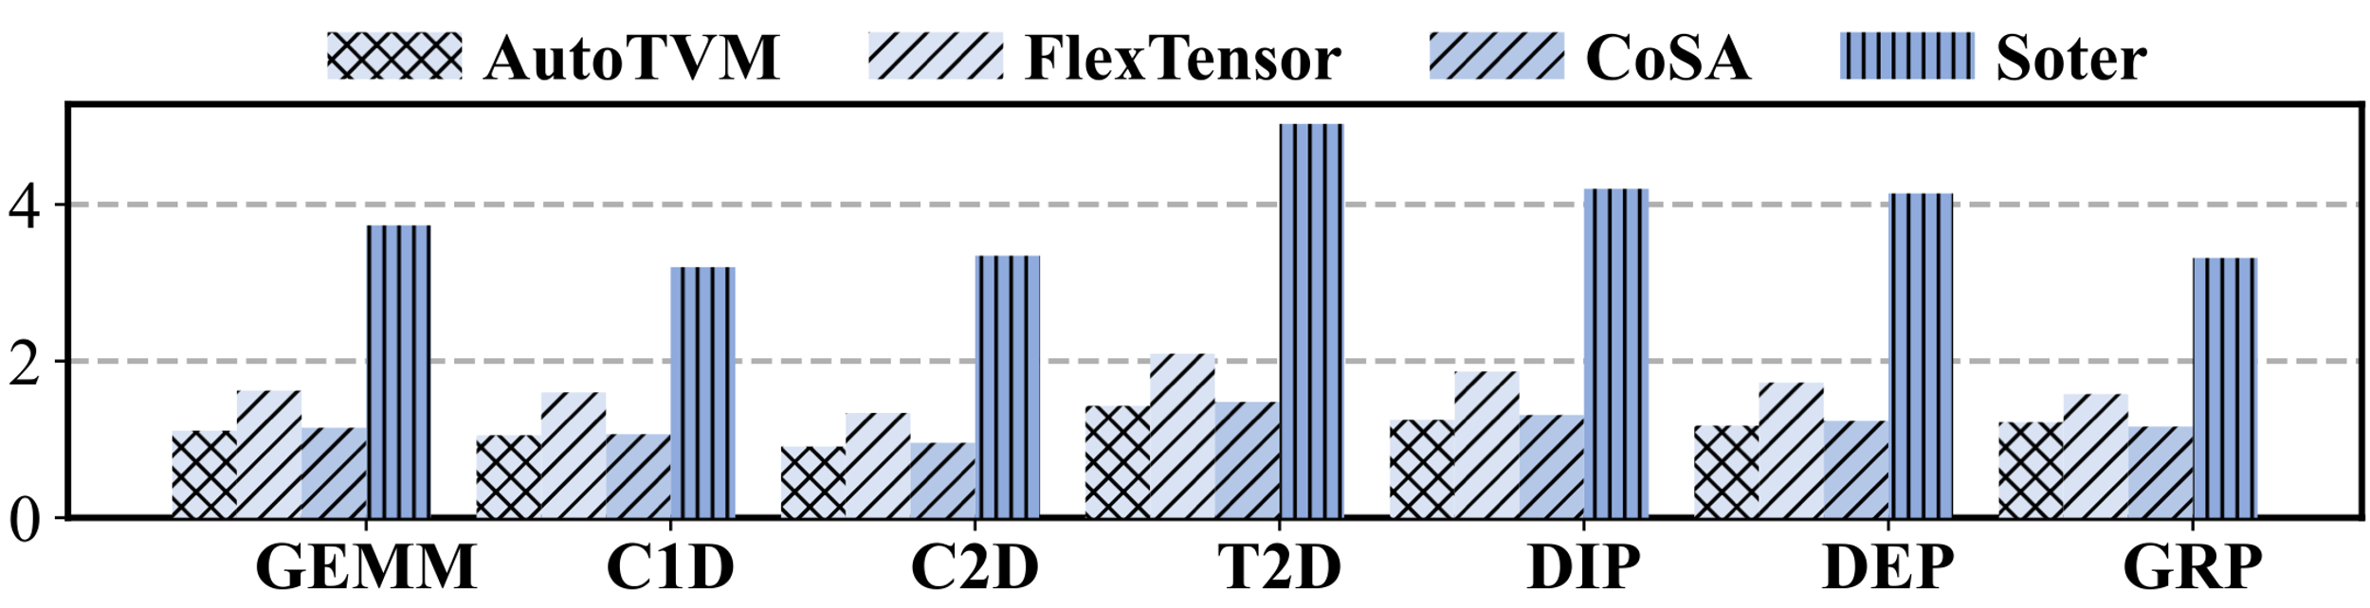
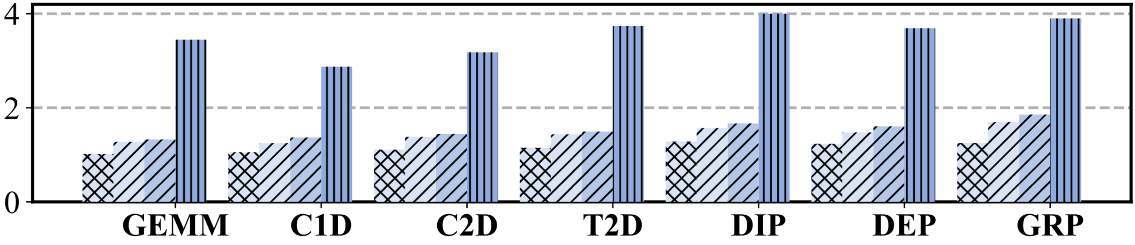
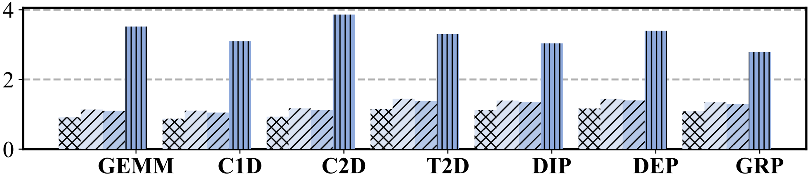
Performance on Operators
(a) Eyeriss
  Batch Size = 1:
  Achieving 2.1~3.5x speedup
(b) Simba
Performance Speedup
(c) NVDLA

Slide 26
Performance on Operators
  NVDLA Batch Size = 16:
  Achieving 2.3x speedup
  Simba Batch Size = 1~64 :
  Achieving 2.4~2.7x speedup
Performance Speedup
GEMM
C2D
  Eyeriss Architecture=1~64x:
  Achieving 2.1~3.0x speedup
GEMM
C2D

Slide 27
Performance on Workloads
Batch Size = 1
  Simba:
  Achieving 2.5~3.6× speedup
Batch Size = 16
Performance Speedup
Batch Size = 1
  NVDLA
  Achieving 2.6~3.4× speedup
Batch Size = 16

Slide 28
Comparison with Mind Mappings
Batch size=1
Performance Speedup
Batch size=16
  On a specifical accelerator
  Achieving 2.9~3.8× speedup

Slide 29
Conclusion
Propose an analytical tensor-architecture model, which defines a set of inequalities to exclude invalid candidates in the program design space.
Propose an automatic program tuner, which exploits Transformer and policy gradient algorithm to avoid evaluating incomplete programs and to converge to high-performance solutions for spatial accelerators.
Build a coordination between analytical modeling and automatic tuning to optimize both tensor programs and program design space.
Questions?
wangfy8@mail2.sysu.edu.cn

